Slide 1


Slide 2
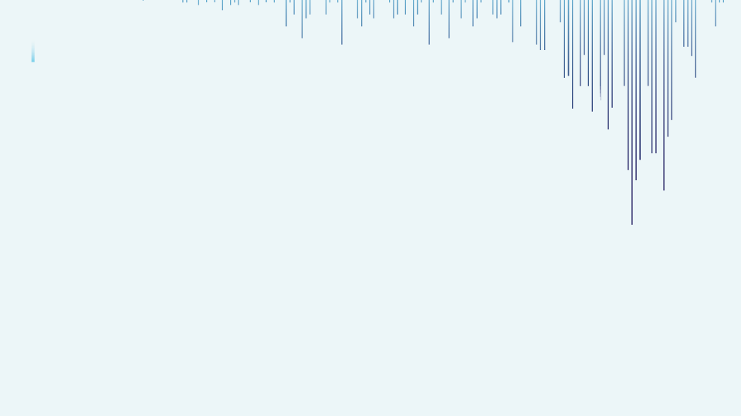



Heart Disease Prediction Analysis
“In the realm of healthcare advancement, this project focusses on the strategic refinement of prediction algorithms utilizing machine learning techniques. By sharpening our focus on heart disease prediction, we aim to pioneer advancements that will redefine the early intervention strategies and contribute to the overall improvement of the patient health outcomes.”
Presented By :Sushil Gupta

Slide 3

Introduction
Data Gathering /Data Refinement
01
Reason / Issues causing Heart Diseases
02
Models and early detection bring essential benefits
Comprehensive Dataset Overview
Refinement and Data Preparation Steps
EXPLORATORY DATA ANALYSIS
Feature Extraction
03
04
Find patterns and identify trends
Divide Features into X and Y
Gain valuable insights from the dataset
Machine Learning / Deep learning
Methodology
06
Experimental results
05
Algorithms or Models Used
Visuals of Compared models
Compare each Evaluate Algorithm
Accuracy, confusion matrix of models
Conclusion
Appendices and references
07
08
Importance of the used approach
Suggestion for future
Links and codes used in the project

Slide 4
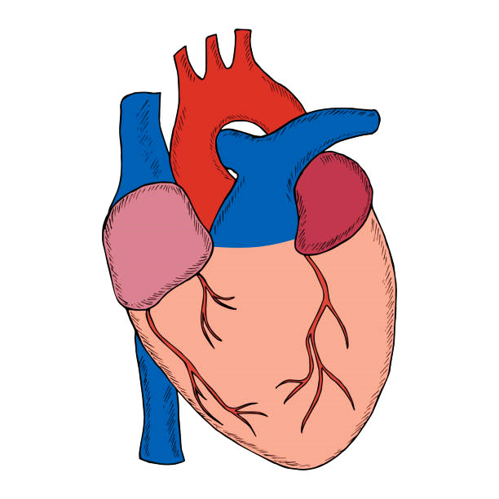

INTRODUCTION
Smoking
Hypertension
Cardiovascular Disease (CVDs) refers to a group of disorders affecting the heart and blood vessels and heart failures is a common event caused by CVDs. Early detection and Data Science models in medicine can help doctors foresee health issues before they become serious.
This dataset forms a comprehensive exploration of patient health indicators within a medical context, specifically focusing on factors related to heart disease.
The datasets encompass 13 vital features such as age, blood pressure, cholesterol, fasting blood sugar, chest pain and more.
The target variable, 'Heart Disease Presence,' signifies the likelihood of an individual having heart disease.
Factors Of Cardiovascular Diseases.
Obesity
Sedentary lifestyle
Hyperlipidaemia
17.9m
Alcohol
33%
Fatalities Caused By CVD (each year)
Global Death

Slide 5



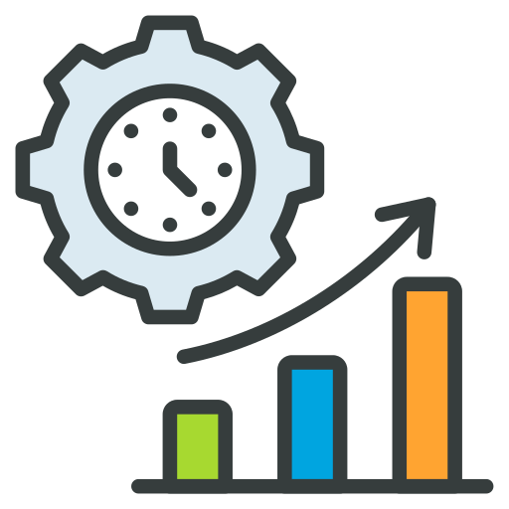


Objective OF The Study
Risk Stratification
Comparing Algorithms
Real - time Monitoring
Value Of The Study
Early detection and Prevention
Improved Patient Outcomes
Public Health Advancement

Slide 6


Monitor and Update
STEP
Continuously monitor the model's performance in the real-world scenario
07
Model Evaluation
STEP
06
Assessing the performance of a machine learning model using metrics
Model Selection and
Model Training
STEP
Choosing a suitable machine learning algorithm and optimizing its parameters
05
Split Train And Test Data
WORK FLOW
WORK FLOW
STEP
04
Dividing the dataset into training and testing sets to evaluate
PREPROCESSING
STEP
Preparing and cleaning data to enhance its quality and suitability
03
Exploratory Data Analysis
STEP
02
Analyzing and visualizing data patterns to understand its characteristics
Data Collection
STEP
Gathering and organizing data to train machine learning models.
01

Slide 7
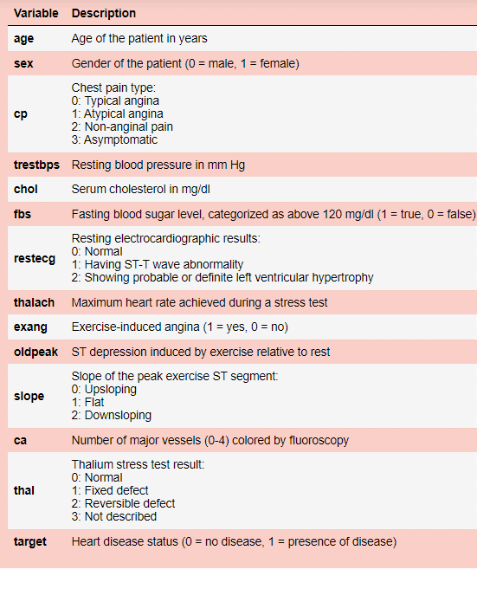
Data Collection & Refinement
1025
13
Heart Failure Prediction
ROWS
Heart_1
COLUMNS
Features
(Columns)
Age
Demographic Information
X
Sex
Clinical Data
Chest Pain Type, Cholesterol, FastingBS, RestingECG,
MaxHR, Exercise Angina,
Old peak, ST Slope
Heart Disease
0: Normal
Y
Outcome Variable
1-Heart Disease

Slide 8

EXPLORATORY DATA ANALYSIS
Exploratory Data Analysis (EDA) helped us understand the data structure, find patterns, identify trends, and gain valuable insights from the dataset.
From EDA we analyze, the distribution of each features, checking the correlation between the features .
Using visuals helped us see the data clearly, understand the clinical data relationship with each other, and pinpoint factors that plays vital role in predictions of heart disease.
The datasets is clean ,as there is no NULL VALUE, but we can find some DUPLICATE VALUES and OUTLIERS.
We looked at our data columns and found 9 columns to be numerical in terms of data types, but they are categorical in terms of semantic. So, we converted them to object for proper analysis.
We used the univariate and bivariate analysis approach to gain insights into individual characteristics of the data and likewise how each feature relates to main goal: predicting the target variable.

Slide 9
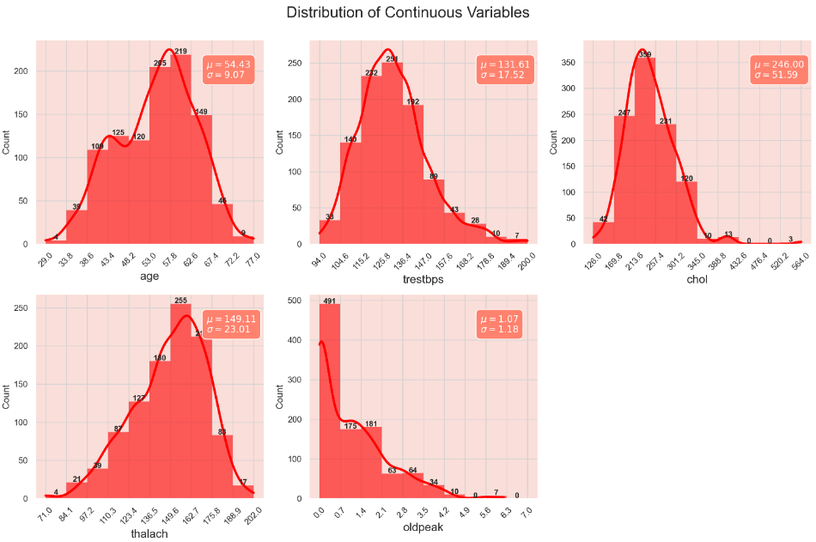
DISTRIBUTION OF CONTINUOUS VARIABLE
Age: Uniform distribution, peak at late 50s , mean age is approx. 54.43 years.
Resting Blood Pressure: Concentration around 120-140 mm Hg, mean is approx. 131.61 mm Hg.
Cholesterol: Avg. between (200- 280 mg/dl).
Thalach: (Maximum heart rate) – Majority of individuals achieve a heart rate between 140-170 bpm during a stress test.
Oldpeak: (ST Depression Induced by Exercise) – Most concentrated towards 0, indicating many individuals did not experience significant ST depression.

Slide 10
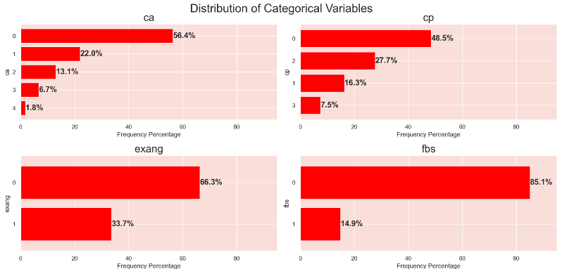
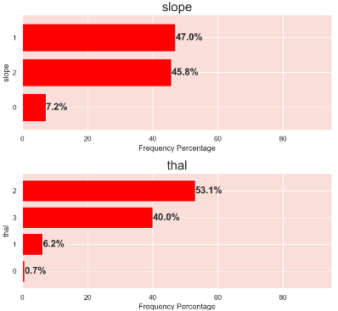
DISTRIBUTION OF CATEGORICAL VARIABLE
Cp (Chest pain): Type (Typical Angina) seems to be most prevalent amongst other.
Fbs (Fasting Blood Sugar): Majority of patients have their Fbs below 120 mg/dl, indicating high Fbs not common condition in dataset.
Exang (Exercise-Induced Angina): Majority of patient do not experience exang, suggesting it might not be common symptoms among the patients in this dataset.
Slope (Slope of the Peak Exercise St Segment): Specific type 1(Flat), and 2(Downsloping) are more common.
Thal (Thallium Stress Test Result): Reversible Defect type 2 seems to be more prevalent than the other.
Ca (No. of major vessels colored by fluoroscopy): Most patients have fewer major vessels with ‘0’ being the most frequent.

Slide 11
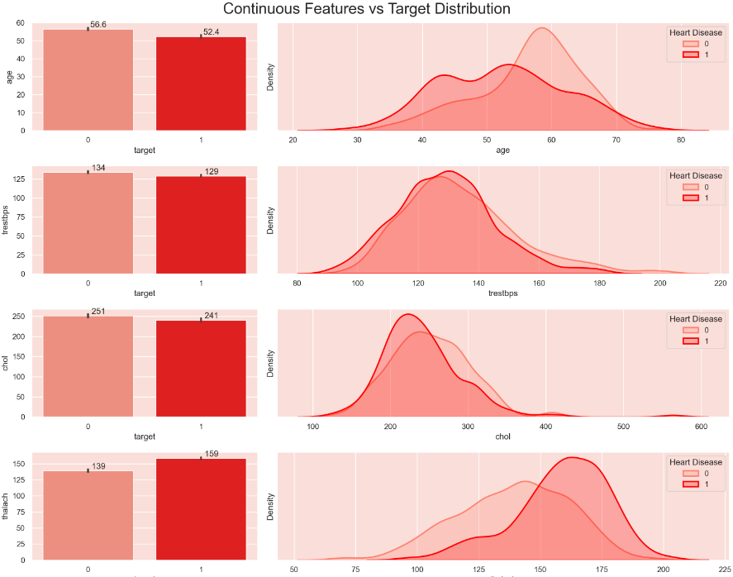
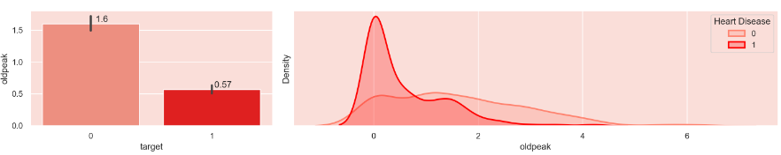
CONTINUOUS FEATURE vs TARGET
Age: Patient having heart disease being a bit younger on average than those without.
Trestbps (Resting BP): Nearly identical indicating limited differentiating power of this feature.
Chol (Serum Cholesterol): Distribution for both categories are quite close but mean for patient with heart disease is slightly lower.
Thalach (Max. Heart Rate Achieved): Noticeable difference in distributions. Patients with heart disease tend to achieve a higher maximum heart rate.
ST Depression (Oldpeak): Lower for patient with heart disease and their distribution nears 0 whereas the non-disease has wider spread.
Thalach → Seems to impact higher followed by ST Depression (Oldpeak), and age.

Slide 12
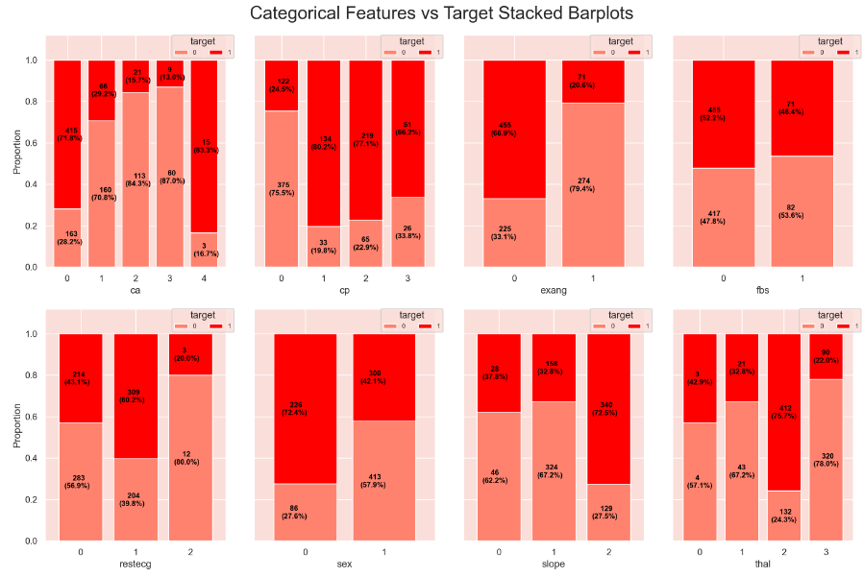
CATEGORICAL FEATURE vs TARGET
Ca (No. of major vessels):
Ca is inversely proportional to heart disease except for last fluoroscopy. 0 – higher proportion (heart disease).
Cp (Chest Pain):
Type 1,2 and 3 have higher proportion of heart disease compared to type 0.
Exang (Exercise induced Angina):
Patient who did not experience exang (0) show higher proportion of heart disease presence as compared to (1).
Fbs (Fasting Blood Sugar):
Similar difference in distributions.
Restecg (Resting ECG):
Type (1) – higher proportion of heart disease presence.
Sex :
Females (1) exhibit a lower proportion of heart disease presence compared to males (0).
Slope (Slope of the Peak Exercise ST Segment):
Slope type 2 has higher proportion of heart disease presence.
Thal (Thallium Stress Test Result):
→ Reversible defect category (2) has a higher proportion of heart disease presence compared to the other categories.
Summary:
Higher Impact on Target: ca, cp, exang, sex, slope, and thal
Moderate Impact on Target: restecg
Lower Impact on Target: fbs

Slide 13
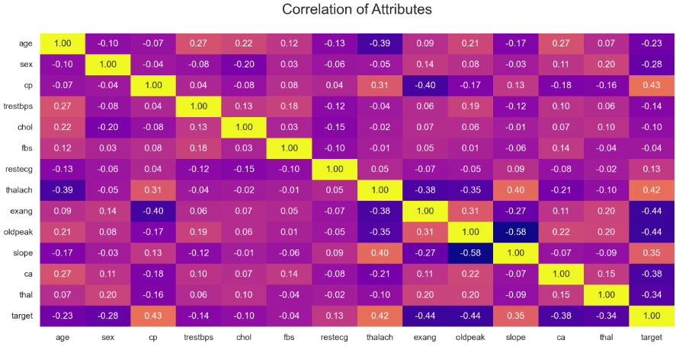
CORRELATION HEATMAP
Positive correlation were observed between the target variables and “Cp”, “Thalach” and “Slope”.
But “Exang”, “Oldpeak”, “Ca” and “Thal" looks like highly negatively correlated with target.
Additionally, “age” and “sex” exhibited moderate correlation with the target.
While “Trestbps”, “Chol”, “fbs” and “restecg” demonstrated minimal correlation with the target.

Slide 14

PREPROCESSSING
Irrelevant Feature Removal: All features in the dataset appears to be relevant based on EDA. We will retain all the columns, ensuring no valuable information is lost, especially given the dataset’s small size.
Missing Value Treatment: No missing value found in the dataset.
Outliers Treatment: Checked outliers using IQR method for the continuous features and upon identifying outliers, nature of algorithm, and given small dataset size direct removal of outliers might not be best approach. Instead, we will apply Box-Cox transformation to stabilize variance and make the data more normal-distribution.
Categorical Feature Encoding: Applied one hot encoding to the columns like “Cp”, “Thal” and “Restecg” since these variables are nominal variables.
Feature Scaling: Are imp. for the algorithms that are sensitive to the magnitude and scale of feature, but not all algorithms requires scaling like Decision Tree are scale-invariant and given our intent to use mix-model we’ve chosen to handle scaling later using pipelines.

Slide 15
TRAIN TEST SPLIT
We divided the data into training (80%) and testing (20%) sets.
Setting a random state ensures consistent results and using stratify=y maintains a proportional distribution of the target variable in both sets.
SPLITING THE DATA INTO X & Y
We divided the dataset into two parts: X and y.
"X" typically represents the independent Variables, and "y" represents the Dependent (target variable) that we want to predict or understand.

Slide 16
MODEL SELECTION
Models used:
Logistic Regression: logistic Regression is commonly used for binary classification problems. it's preferred because it provides a simple an efficient way to model the relationship between the independent variables and the probability of a certain outcome.
Decision Tree: Decision Tree algorithms are used for classification because they are simple, computationally efficient, and effective in handling high-dimensional data.
Works best for categorical independent columns.
Support Vector Machine: SVM is a powerful supervised algorithm that works best on smaller datasets but on complex ones. Support Vector Machine(SVM)can be used for both regression and classification tasks, but generally, they work best in classification problems.
Random Forest Algorithm: Random Forest: Random Forest is a robust supervised algorithm suitable for both regression and classification tasks.

Slide 17


Accuracy
Precision
Recall
F1-Score
%
%
%
%
Understanding
Support Vector Machine | 99 | 100 | 98 | 99
Random Forest Classifier | 88 | 85 | 93 | 89
Decision Tree | 88 | 87 | 90 | 88
Logistic Regression | 82 | 82 | 85 | 83
Precision: The accuracy of the model when it claims to have found something.
Recall: Recall: The ability of a model to find all the relevant cases
F1 Score: A balance between recall and precision, useful when both false positives and false negatives need to be minimized.
Experimental Results :
SVM Dominates: Support Vector Machine excels with 99% accuracy, balanced precision (100%) and recall (98%), showcasing superior overall classification performance.
Percentage (%)
Random Forest & Decision Tree Consistency: Both algorithms maintain 88% accuracy, with Decision Tree having higher precision (87%) and Random Forest higher recall (93%).
Logistic Regression: LR achieves 82% accuracy and high precision (82%) but lower recall (80%).

Slide 18





Conclusion
Conclusion
Key Findings
The results indicated that the Support vector Machine model had the highest accuracy of 99%
The study utilized the Kaggle Heart Failure Prediction dataset with 1025 instances, and all algorithms were implemented on Jupyter Notebook
The accuracies of all algorithms were above 83% with the lowest accuracy of 83% given by Logistic Regression and the highest accuracy given Support vector Machine as previously mentioned.
Limitations
Single and Small Size Dataset Limitation:
The study relies on a single dataset, potentially limiting its generalizability to diverse populations.
Limited Variable Consideration:
The analysis focuses narrowly on demographic and clinical variables, overlooking lifestyle and genetic factors relevant to heart health.
Lack of Test Dataset Evaluation:
The model's performance on new, unseen data is not evaluated, raising concerns about its real-world applicability.
Future research
Future research must ensure robustness, generalizability, and interpretability for informed decision-making based on study findings. It's important to check how duplicate data and unusual values affect the model's accuracy. Creating strategies to deal with these issues is valuable for improving model performance.

Slide 19


